Slide 1
Picture in Picture
&
Sensors
By
Shubham Kamdi
Frederick Tan
Benita Rego
Nolita Rego

Slide 2
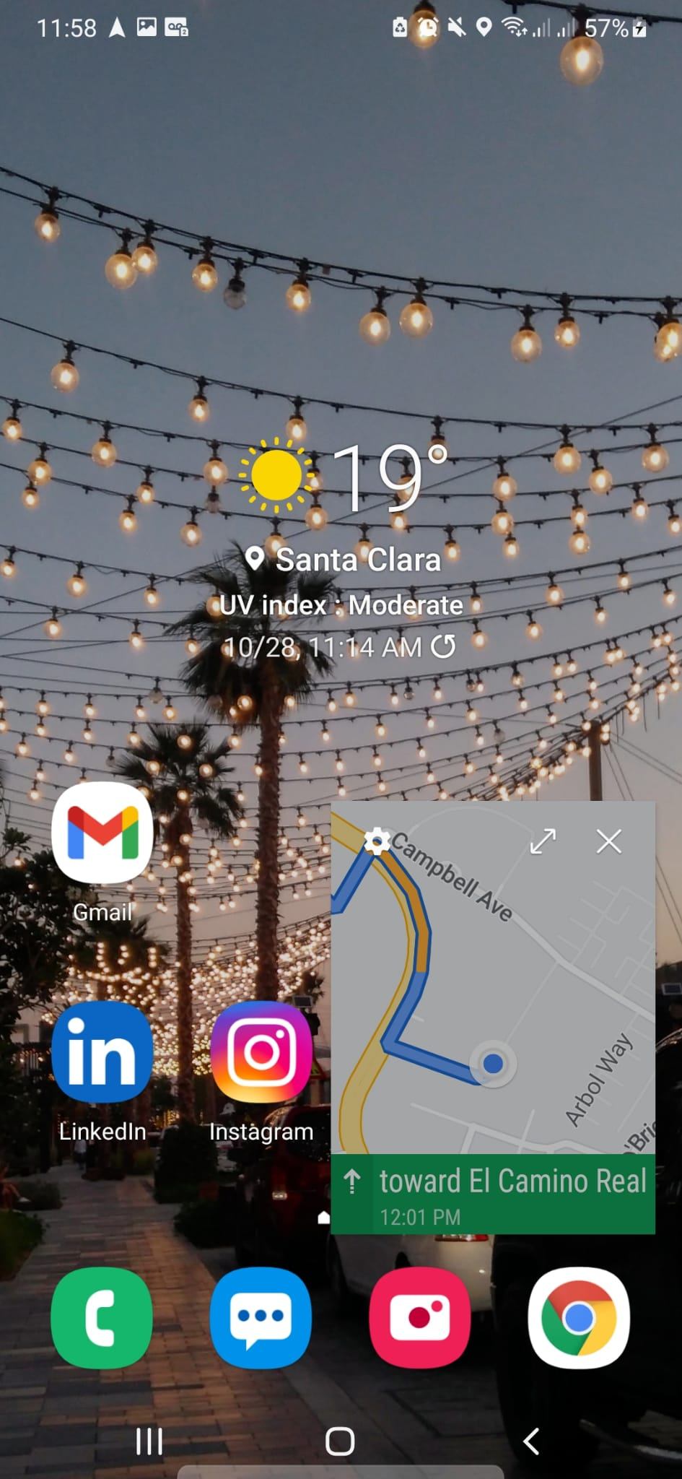
What is Picture in Picture (PIP)?
PIP is a special type of multi-window mode mainly used for activities that need to be active on screen but should not take up the whole screen space.
Android 8.0 (API level 26) and above allows activities to launch in PIP mode.
PIP is a special type of multi-window mode mainly used for activities that need to be active on screen but should not take up the whole screen space.
Android 8.0 (API level 26) and above allows activities to launch in PIP mode.
https://developer.android.com/guide/topics/ui/picture-in-picture

Slide 3
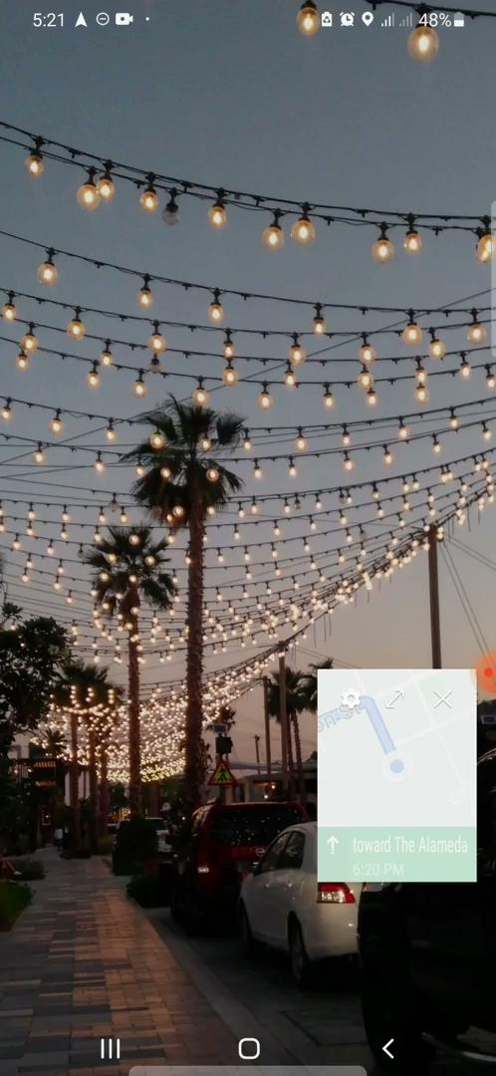
How users can interact with the PiP window?
Users can drag the PiP window to another location.
Single-tap the window to display a full-screen toggle.
Double-tap the window to toggle between the current PiP size and maximum PiP size.

Slide 4
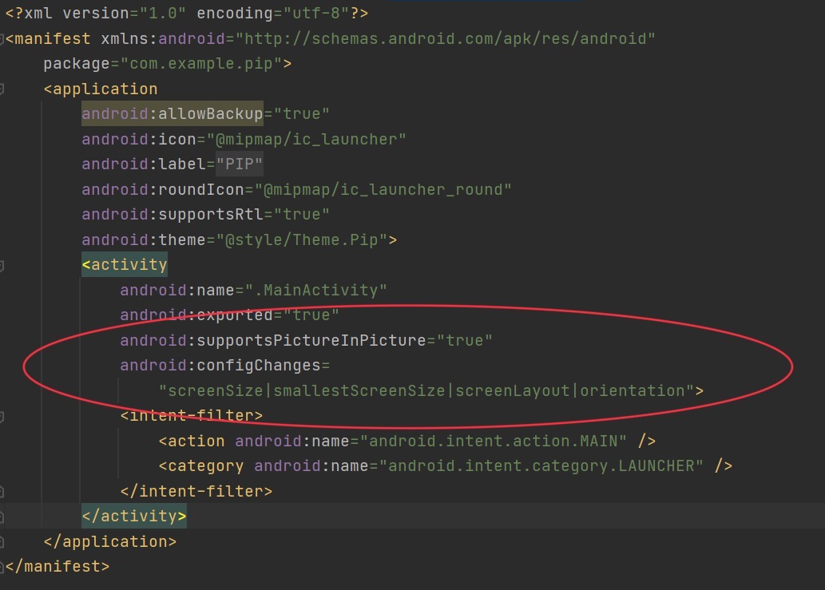
Source Code:
Declaring picture-in-picture support in the Manifest file

Slide 5
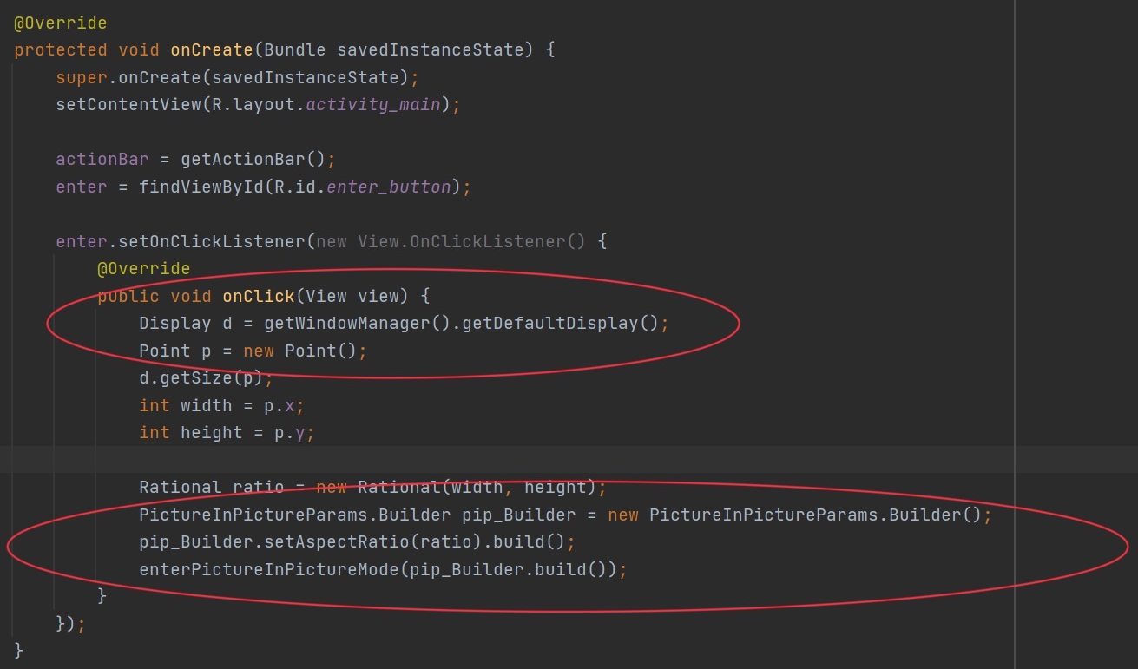
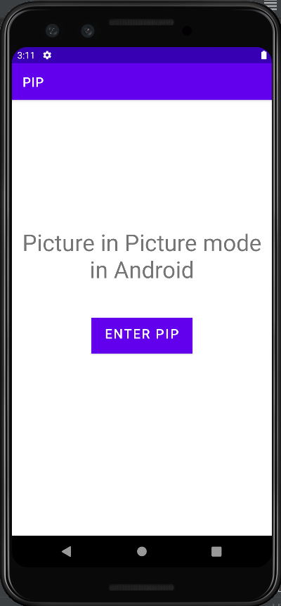
Here, we will change the MainActivity.java file to PIP mode on a button click:

Slide 6
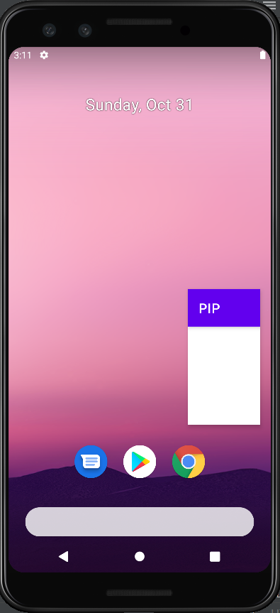
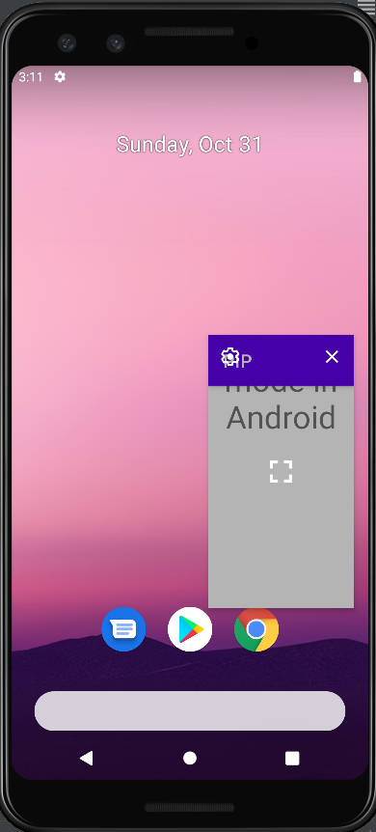
Picture-in-Picture mode on Emulator
(On single tap)
(On double tap)

Slide 7
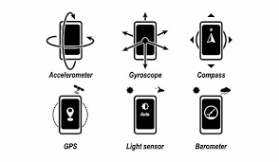
Sensors
Android sensors are virtual devices that provide data coming from a set of physical sensors:
Accelerometers
Gyroscopes
Barometer
Humidity
Light
Proximity
Heart rate sensors
https://source.android.com/devices/sensors

Slide 8
The Android platform supports three broad categories of sensors:
Motion sensors These sensors measure acceleration forces and rotational forces along three axes. This category includes accelerometers, gravity sensors, gyroscopes, and rotational vector sensors. https://developer.android.com/guide/topics/sensors/sensors_motion
Environmental sensors These sensors measure various environmental parameters, such as ambient air temperature and pressure, illumination, and humidity. This category includes barometers, photometers, and thermometers. https://developer.android.com/guide/topics/sensors/sensors_environment
Position sensors These sensors measure the physical position of a device. This category includes geomagnetic sensors and proximity sensors. https://developer.android.com/guide/topics/sensors/sensors_position

Slide 9
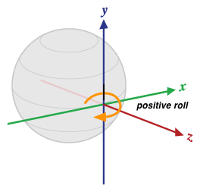
Rotation Vector Sensor
reports the orientation of the device relative to the East-North-Up coordinates frame
Data obtained by integration of accelerometer, gyroscope, and magnetometer readings
Gyroscope required for main orientation change input
Accelerometer and magnetometer used to make up for gyroscope drift

Slide 10
Rotation Vector Sensor
orientation of the phone is represented by the rotation necessary to align the East-North-Up coordinates with the phone's coordinates
can be seen as rotating the phone by an angle theta around an axis to go from the reference device orientation to the current device orientation
encoded as the four unit-less x, y, z, w components of a unit quaternion

Slide 11
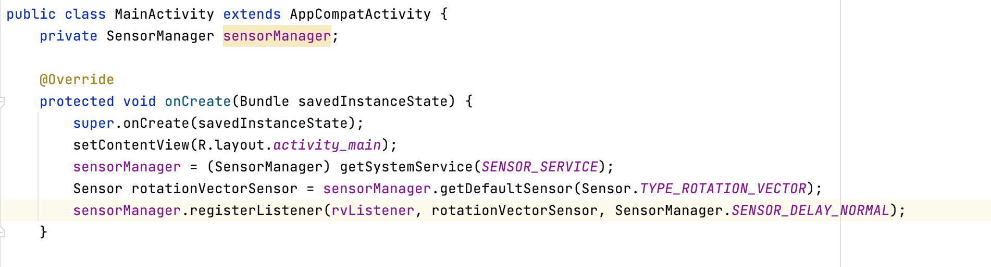
Source Code
Rotate the phone 45 degrees to change background color

Slide 12
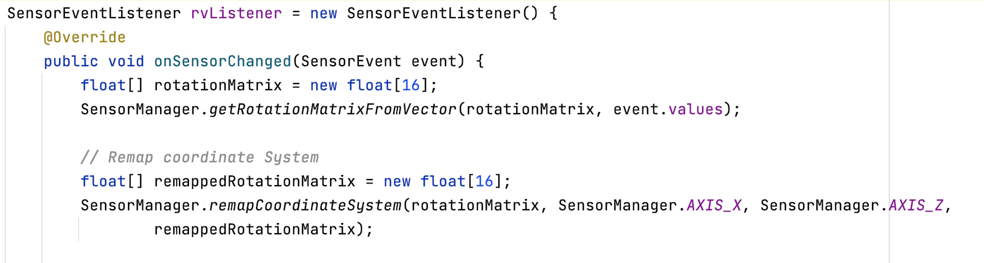
Source Code

Slide 13
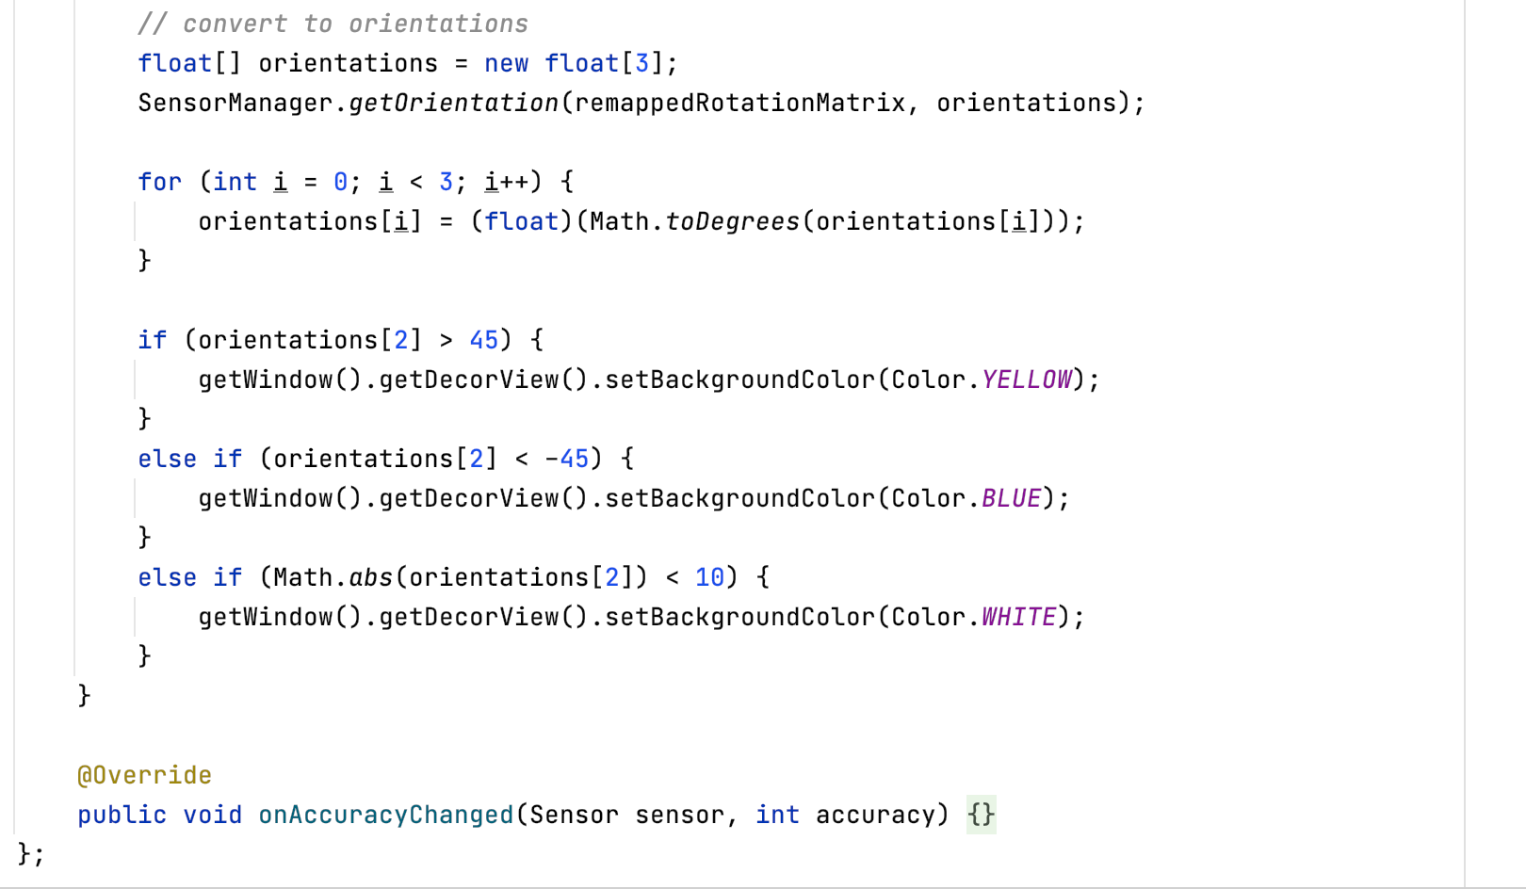
Source Code

Slide 14
Proximity Sensor
As the name suggests, proximity sensor are used to detect objects in proximity to the android devices.
This sensor is primarily used during phone calls, to detect the position of the user with respect to the mobile phone.
Typically during a phone call one would not want your device to register unnecessary touch.
Proximity sensors will detect whether the face of the user is touching the screen of the phone and accordingly disable the touch events until the phone call completes.

Slide 15
Setup
First of all, you will need to add :
<uses-feature android:name = "android.hardware.sensor.proximity" />
This line to your manifest file just beneath the application tag.
This line will make sure that google play store is aware that your application uses the proximity sensor.
Next in your java code you will need to instantiate the objects for:
Sensor Manager
Sensor
Sensor Event Listener

Slide 16
Setup
Head over to onResume method of your Java code, instantiate the objects as mentioned in the previous slide.
Firstly your sensorManager object needs to be initialized, by using getSystemService method.
Using the sensorManager object you need to initialize the proximitySensor object by calling getDefaultSensor method of sensorManager object.
Next, you will need to initialize the sensor event listener, which consists of two override methods namely:
1. onSensorChanged(SensorEvent event)
2. onAccuracyChanged(Sensor sensor, int accuracy)

Slide 17
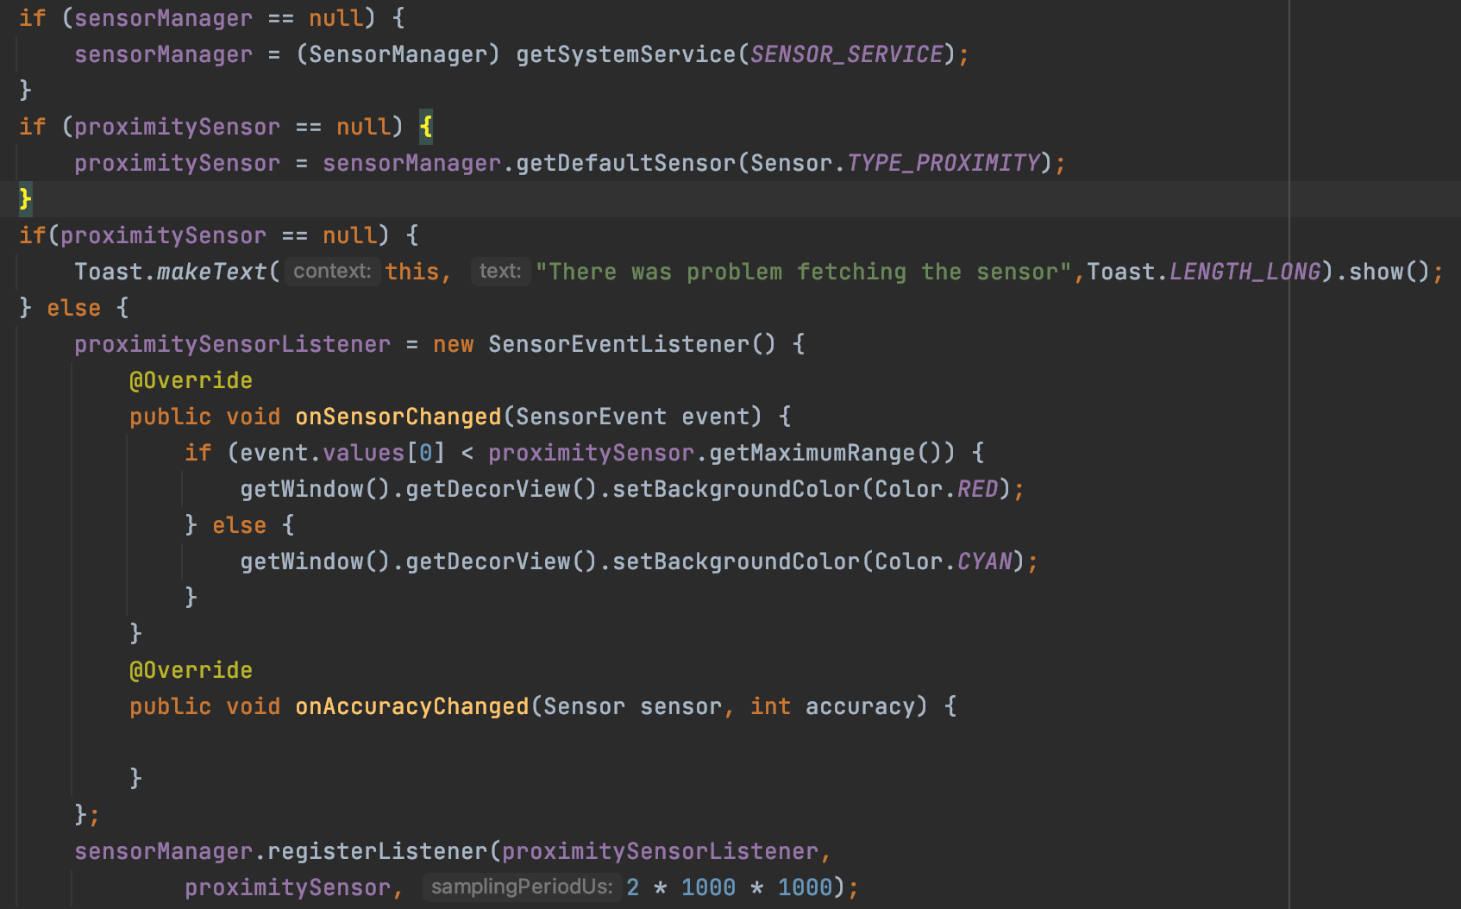
Source Code

Slide 18
Thank you

